Slide 1
Bayesian Inference
Presented By: Michael Remington
Brought to you by: Gradquant at UCR

Slide 2
Free Learning Resources
Books
Bayesian Inference Python:
https://bayesiancomputationbook.com/markdown/chp_01.html
Bayesian Statistics in R:
https://statswithr.github.io/book/
Youtube Tutorials
Ben Lambert:
https://www.youtube.com/watch?v=P_og8H-VkIY&list=PLwJRxp3blEvZ8AKMXOy0fc0cqT61GsKCG
3blue1Brown:
https://www.youtube.com/watch?v=HZGCoVF3YvM
Ritvikmath
https://www.youtube.com/watch?v=-1dYY43DRMA&list=PLvcbYUQ5t0UEkf2NUEo7XSsyVTyeEk3Gq

Slide 3
Table of Contents
Introduction
What is Bayesian Inference?
Bayesian vs Frequentist Framework
Probability Refresher
Conditional Probabilities
Marginalizing
Quick intro to Probability Distributions
Understanding Bayesian Concepts
Bayes Theorem
Priors
Likelihood
Posterior
Break
Practical Example of a coin toss
Bayesian Data Analysis

Slide 4
Introduction

Slide 5

Statistical Inference
Life is noisy!
Statistical Inference is a logical framework to make sense of this noise and uncertainty which we use to test our beliefs versus data
Statistical inference is probabilistic
Lambert, Ben. A Student’s Guide to Bayesian Statistics. Sage, 2018.

Slide 6
Bayesian vs Frequentist Framework
Frequentist
Probability is interpreted as the long-run frequency of an event occurring in an infinite number of repeated, hypothetical experiments.
Sample of data is the result of one of an infinite number of exact repeated experiments
Data is assumed to be random and the results of sampling from a fixed population distribution
P value usually the metric for certainty
Bayesian
Probability is interpreted as a measure of uncertainty or degree of belief in an event.
incorporates both prior information and current data to update beliefs
Gives us the of the probability of getting our parameter value

Slide 7

Bayes Theorem

Slide 8
Probability Refresher

Slide 9
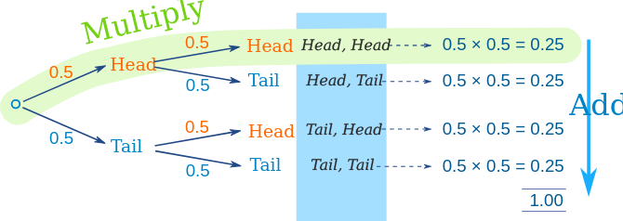
Notation and Conditional Probabilities
Event (A)
Probability (P(A)): The probability of event A occurring.
P(B|A): Whats the probability of b happening given A already occurred?
Conditional probability: captures how the probability of one event changes when you have information about another event.

Slide 10
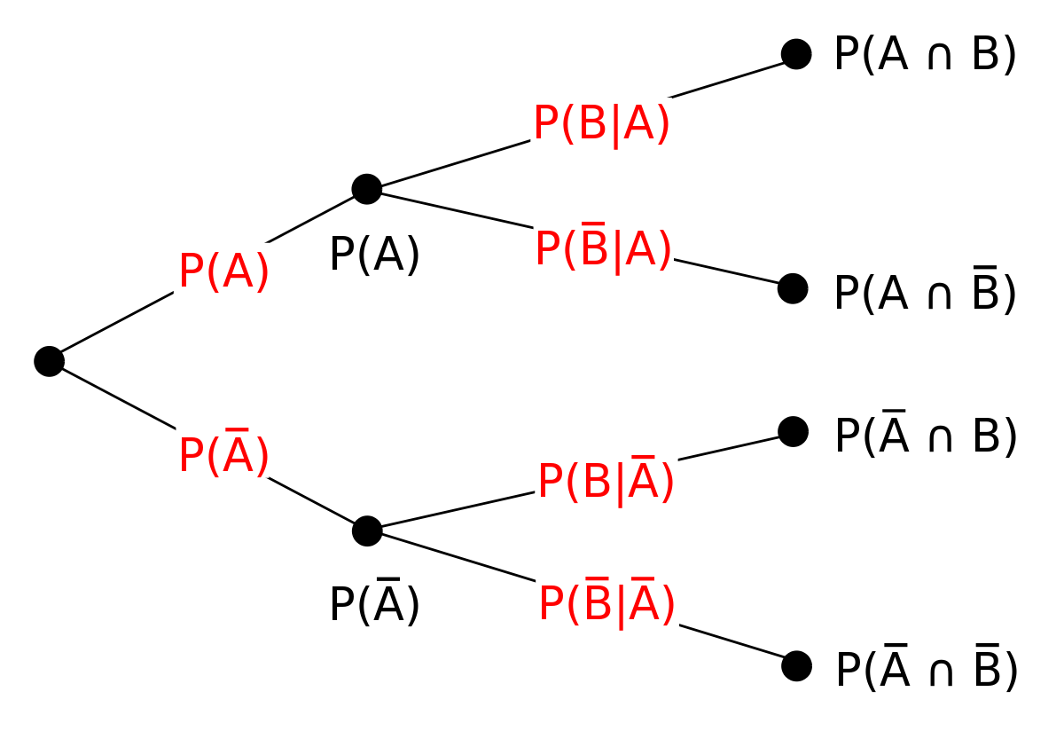
Multiplication Rule
P(A∩B)=P(A∣B)⋅P(B)

Slide 11
Marginalization
Used to reduce dimensionality
Female
Male
Smoker
0.3
0.1
Non Smoker
0.2
0.4

Slide 12
Marginalization
Female
Male
Smoker
0.3
0.1
Female
Male
0.5
0.5
Non Smoker
0.2
0.4

Slide 13
Marginalization
Female
Male
Smoker
0.3
0.1
Smoker
0.4
Non Smoker
Non Smoker
0.2
0.4
0.6

Slide 14
Understanding Bayesian Concepts

Slide 15
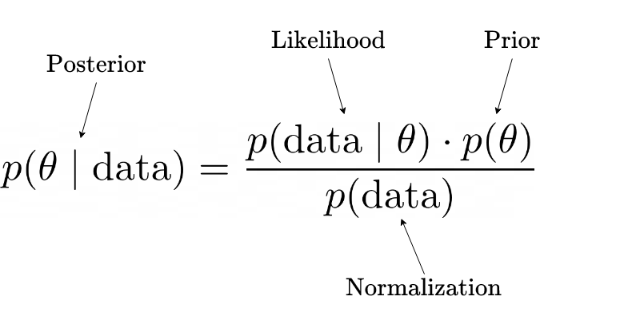
Bayes Theorem for Inference
(Marginal Likelihood)

Slide 16
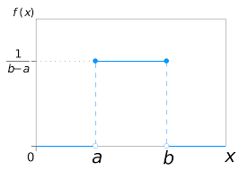
How to pick a Prior function
Pick a probability distribution function you think matches your data
Non-Informative (Weakly Informative) Priors:
If you have little prior knowledge about the parameter being estimated, consider non-informative or weakly informative priors.
Non-informative priors aim to have minimal influence on the posterior, allowing the data to drive the inferences.
Examples include the uniform priors.
Informative Priors:
If you have substantial prior information or beliefs about the parameter, use informative priors.
Informative priors express your prior knowledge and can help regularize the inference.
For example, if you're estimating a population mean and you have historical data, you can use a normal distribution with a mean and standard deviation based on that historical data as the prior.

Slide 17
How to pick a Likelihood function
Write down the real life behavior that the model should be capable of explaining
Write down the assumptions of this behavior
Is it continuous or discret?
Are the values independent of one another?
Can two trials happen simultaneously?
Find a probability model that best fits your assumption
Bernoulli
Binomial
Poisson
Many More!
Determine model fit and evaluate if any assumptions were violated. If the model doesn’t fit very well go back to step 2!

Slide 18
Different Types of Probability Distributions
https://ben18785.shinyapps.io/distribution-zoo/

Slide 19
MCMC
http://chi-feng.github.io/mcmc-demo/app.html?algorithm=RandomWalkMH&target=banana

Slide 20
Code

